Slide 1
Intersection between a Straight Line and a Circle

Slide 2
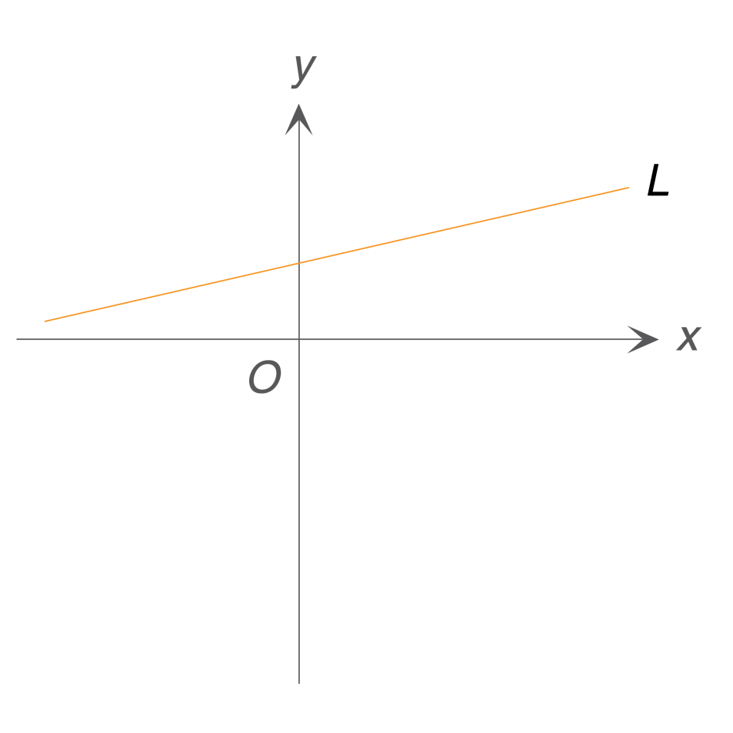
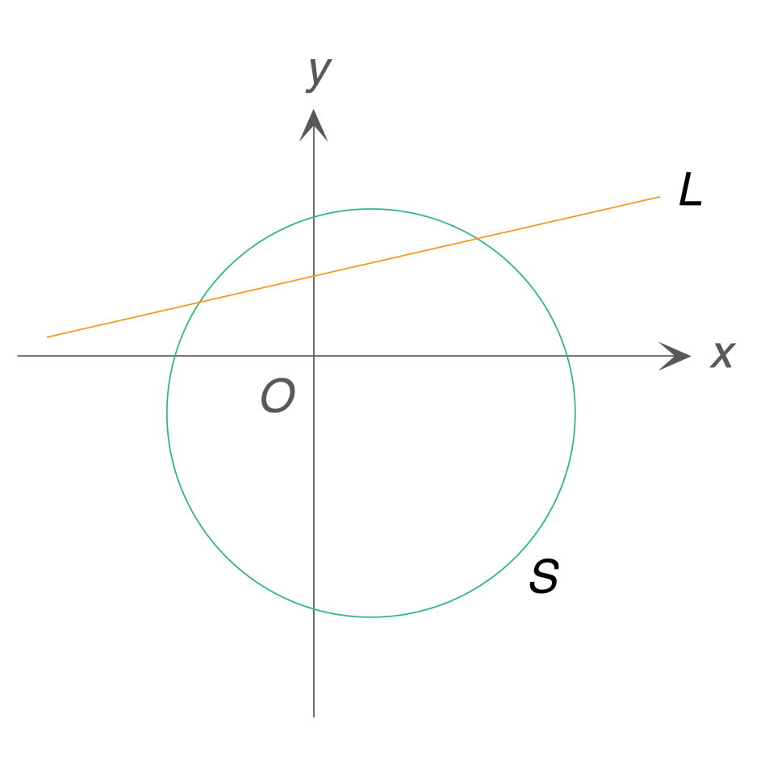
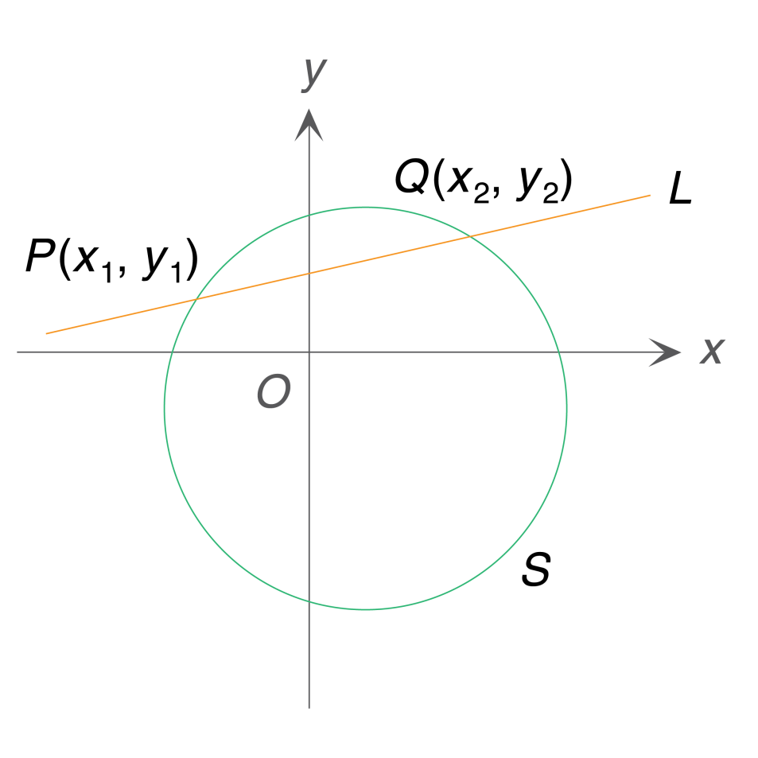

Coordinates of the Intersections between a Straight Line and a Circle
and a circle S: x² + y² + Dx + Ey + F = 0.
Consider a straight line L: Ax + By + C = 0
How can we find the coordinates of the intersections between L and S?

Slide 3

Coordinates of the Intersections between a Straight Line and a Circle
and a circle S: x² + y² + Dx + Ey + F = 0.
Consider a straight line L: Ax + By + C = 0
Since P and Q lies on both the straight line L and the circle S,
the coordinates of P and Q must satisfy both the equation of L and the equation of S.

Slide 4
Coordinates of the Intersections between a Straight Line and a Circle
and a circle S: x² + y² + Dx + Ey + F = 0.
Consider a straight line L: Ax + By + C = 0
The coordinates of P and Q are solutions of
.

Slide 5


Coordinates of the Intersections between a Straight Line and a Circle
and a circle S: x² + y² + Dx + Ey + F = 0.
Consider a straight line L: Ax + By + C = 0
Hence, by solving the system of simultaneous equations
,
we can find the coordinates of P and Q.

Slide 6
Follow-up question
Find the coordinates of the intersections between
L: x – y – 2 = 0 and S: x² + y² + 5x – 3y – 10 = 0.
From (1), we have
y = x – 2 ......(3)
By substituting (3) into (2), we have
x² + (x – 2)² + 5x – 3(x – 2) – 10 = 0
x² + x² – 4x + 4 + 5x – 3x + 6 – 10 = 0
2x² – 2x = 0
2x(x – 1) = 0
x = 0 or x = 1

Slide 7
By substituting x = 0 into (3), we have
y = 0 – 2 = –2
By substituting x = 1 into (3), we have
y = 1 – 2 = –1
∴ The coordinates of the intersections between
L and S are (0, –2) and (1, –1).

Slide 8
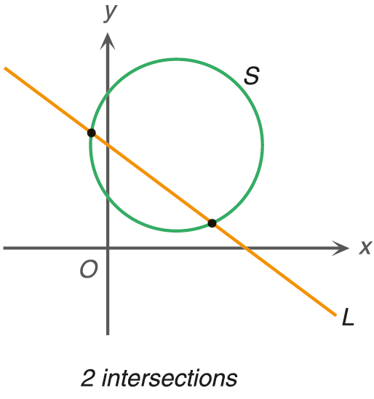
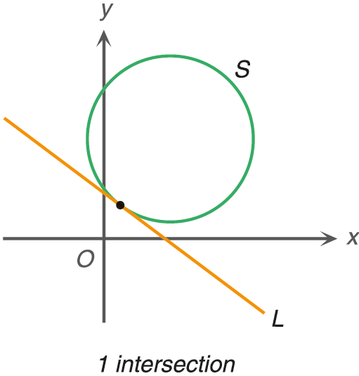
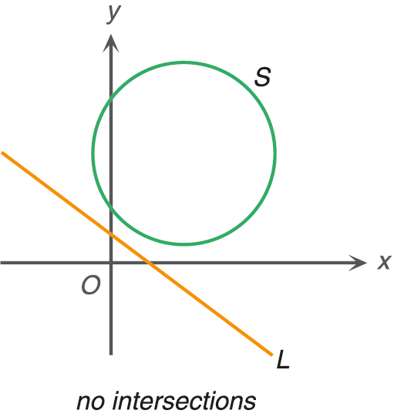
Number of Intersections between a Straight Line and a Circle
Consider a straight line L: y = mx + c and a circle S: x² + y² + Dx + Ey + F = 0.
They may have two, one or no intersections as shown below.

Slide 9
Suppose the equation of the straight line L and the equation of the circle S are given by
By substituting (1) into (2), we have
If we just want to find the number of intersections between L and S, we can find it without solving (*).

Slide 10
Suppose the equation of the straight line L and the equation of the circle S are given by
By substituting (1) into (2), we have
Note that the real root(s) of (*) are the x-coordinate(s) of the intersections between the straight line L and the circle S.

Slide 11
Suppose the equation of the straight line L and the equation of the circle S are given by
By substituting (1) into (2), we have
Hence, we can determine the number of intersections between L and S by the discriminant (Δ) of (*).

Slide 12
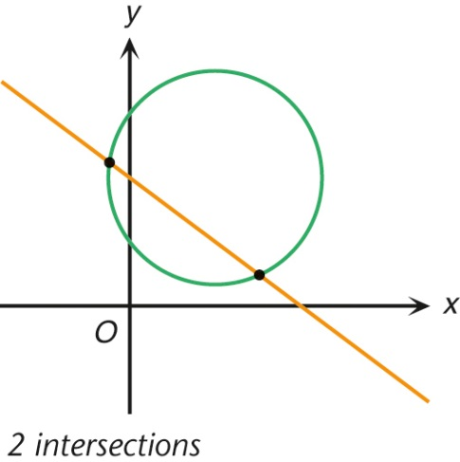
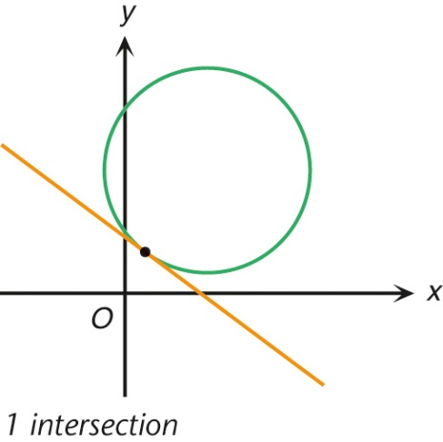
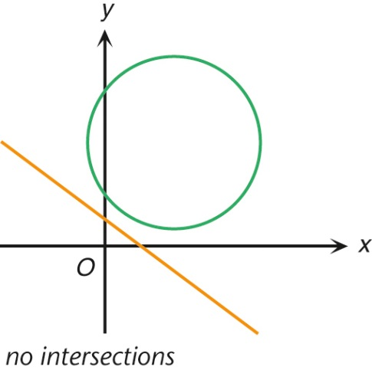
Consider the discriminant (Δ) of (1 + m²)x² + (2mc + D + Em)x + (c² + Ec + F) = 0.
Case 1: Δ > 0
Case 2: Δ = 0
Case 3: Δ < 0
2 intersections
1 intersection
no intersections
e.g.
e.g.
e.g.
L
L
S
L
S
S
tangent
If Δ = 0, then L is a tangent to S. Conversely, if L is a tangent to S, then Δ = 0.

Slide 13
Example: Determine the number of intersections between the straight line L: y = –2x + 6 and the circle S: x² + y² – 2y – 4 = 0.
By substituting (1) into (2), we have
For the equation x² – 4x + 4 = 0,
Δ = (–4)² – 4(1)(4) = 0
∴ There is one intersection between L and S.

Slide 14
Follow-up question
Find the number of the intersections between L: y = 2x – 1
and S: x² + y² – 3x – 4y + 5 = 0.
......(1)
......(2)
By substituting (1) into (2), we have
x² + (2x – 1)² – 3x – 4(2x – 1) + 5 = 0
x² + 4x² – 4x + 1 – 3x – 8x + 4 + 5 = 0
5x² – 15x + 10 = 0
x² – 3x + 2 = 0

Slide 15
For the equation x² – 3x + 2 = 0,
Δ = (–3)² – 4(1)(2) = 1 > 0
∴ There are two intersections between L and S.

Slide 16
Finding the Equations of Tangents to a Circle
Now, we are going to discuss how to find the equations of tangents to a circle under different given conditions.

Slide 17
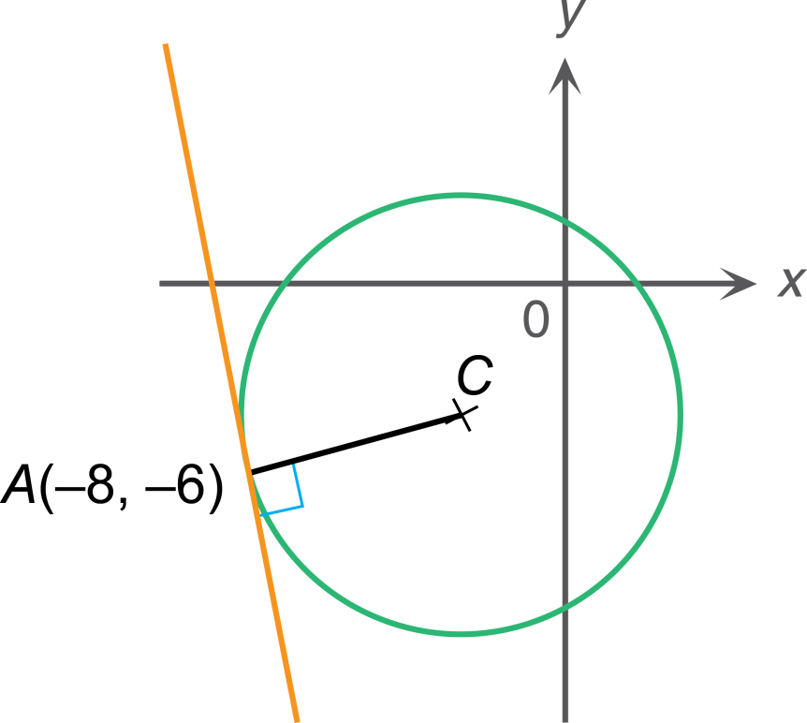
Tangent to a Circle at a Point
Find the equation of the tangent to the circle
x² + y² + 6x + 8y – 4 = 0 at the point A(–8, –6).
Let C be the centre of the circle.
Knowing that CA is perpendicular to the tangent , we can find the slope of the tangent from the slope of CA.
The required tangent passes through this point. We need to know its slope to find its equation.

Slide 18
Tangent to a Circle at a Point
Find the equation of the tangent to the circle
x² + y² + 6x + 8y – 4 = 0 at the point A(–8, –6).
Let C be the centre of the circle.
Coordinates of C =
Slope of CA =
Slope of the tangent at A =

Slide 19
Tangent to a Circle at a Point
Find the equation of the tangent to the circle
x² + y² + 6x + 8y – 4 = 0 at the point A(–8, –6).
∴ The equation of the tangent to the circle at A is

Slide 20
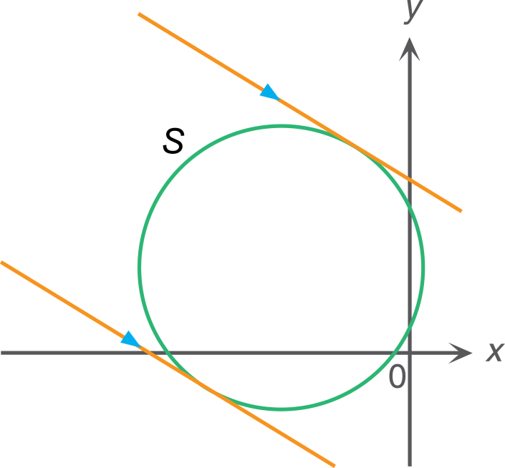
Tangents to a Circle with a Given Slope
Now, suppose we do not know where the tangent touches the circle, but we know the slope of the tangent. For example:
Find the equations of the tangents to the circle
S: x² + y² + 8x – 4y + 2 = 0 with slope –1.
Step 1
Let the equation of the tangent be
y = –x + c ......(1)
slope
y-intercept

Slide 21
Step 2
Substitute (1) into x² + y² + 8x – 4y + 2 = 0.
x² + (–x + c)² + 8x – 4(–x + c) + 2 = 0
x² + x² – 2cx + c² + 8x + 4x – 4c + 2 = 0
2x² + 2(6 – c)x + c² – 4c + 2 = 0 ......(*)
Step 3
Δ of (*) = 0
[2(6 – c)]² – 4(2)(c² – 4c + 2) = 0
If y = –x + c is a tangent to S, then Δ = 0.
(6 – c)² – 2(c² – 4c + 2) = 0
36 – 12c + c² – 2c² + 8c – 4 = 0
c² + 4c –32 = 0
(c + 8)(c – 4) = 0
c = –8 or c = 4
∴ The equations of the tangents are y = –x – 8 and y = –x + 4.

Slide 22
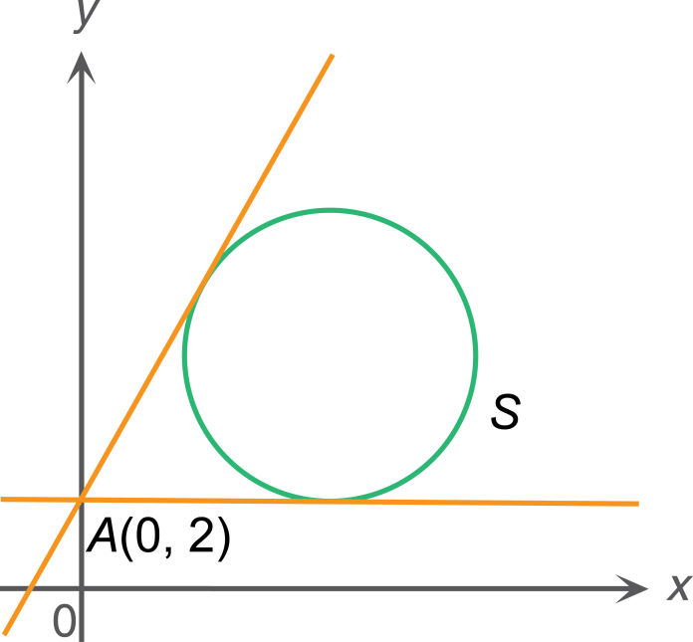
Tangent to a Circle from a Given Point
Find the equations of the tangents to the circle
S: x² + y² – 8x – 10y + 32 = 0 from the point A(0, 2).
Step 1
Let the equation of the tangent be
y = mx + 2 ......(1)
slope
y-intercept

Slide 23
Step 2
Substitute (1) into x² + y² – 8x – 10y + 32 = 0.
x² + (mx + 2)² – 8x – 10(mx + 2) + 32 = 0
x² + m²x² + 4mx + 4 – 8x – 10mx – 20 + 32 = 0
(1 + m²)x² – (6m + 8)x + 16 = 0 ......(*)
Step 3
Δ of (*) = 0
[–(6m + 8)]² – 4(1 + m²)(16) = 0
(3m + 4)² – 16 – 16m² = 0
If y = mx + 2 is a tangent to S, then Δ = 0.
9m² + 24m +16 – 16 – 16m² = 0
–7m² + 24m = 0
m(–7m + 24) = 0
24
m = 0 or m =
7
∴ The equations of the tangents are
y = 2 and .
24
y
=
x
+
2
7

